Slide 1
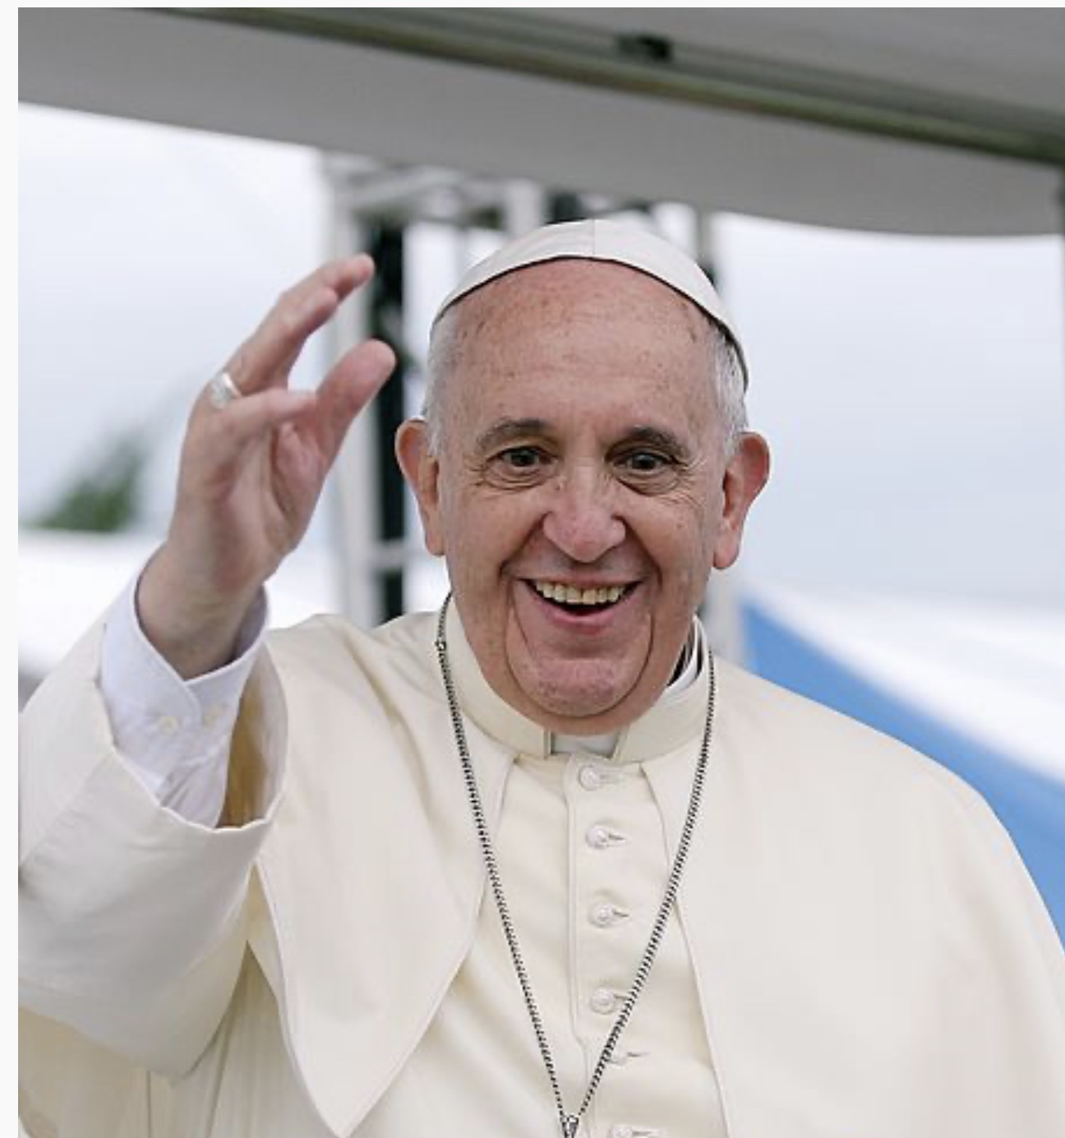

PAPA FRANCESCO
JORGE MARIO BERGOGLIO

Slide 2
Name: Jorge Mario Bergoglio (PAPA FRANCESCO)
Nationality : Argentina (Buenos Aires)
Birthday: 17 december
Star sign: Sagittarius
Occupation: PAPA
Famous for: Representative of the Christian community Worldwide

Slide 3
Papa Bergoglio, is famous for representative of the christian community worldwide. His birthday is on 17 th december, and he’s an sagittarius.
Sagittarius are generous and good.
He was elected pontiff on March 13 th 2013.
At the age of 21, due to severe pneumonia, the upper part of his right lung is removed.
He is a man loved by all religions, especially for us Christians.
He is concerned about poverty and economic inequality and is attentive to the marginalized.

Slide 4
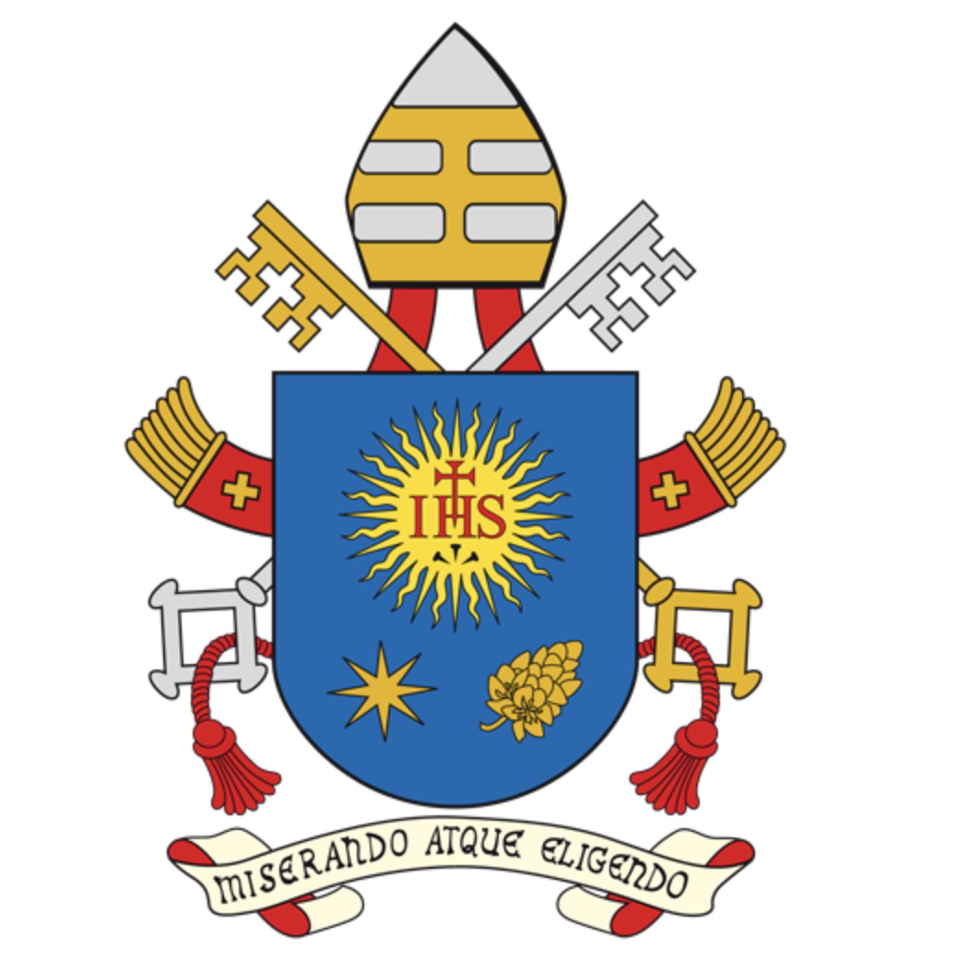
Il suo motto:”Miserando atque eligendo”

Slide 5
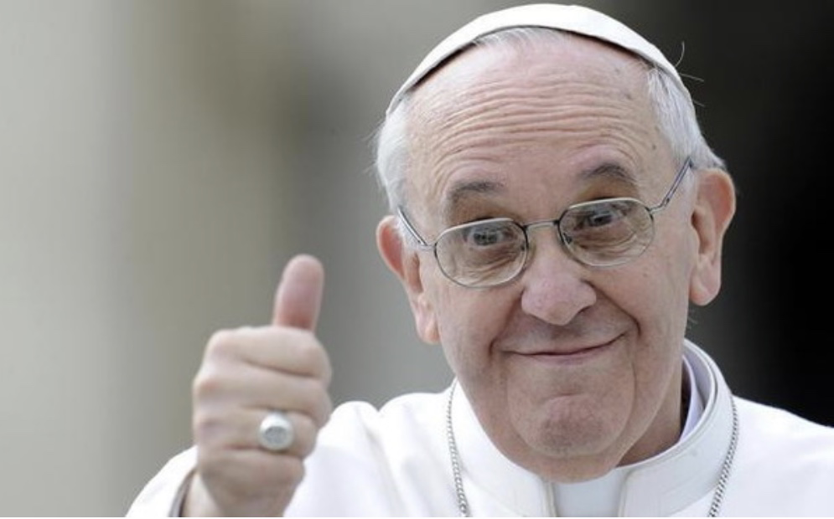
Lorenzo SAPORITI (capogruppo)
Sophia BUENO
Nicolò CALISTRI
Lucia NAGLIERI
Marco SPERANZA

