Slide 1
Topic n1
Describe yourself

Slide 2
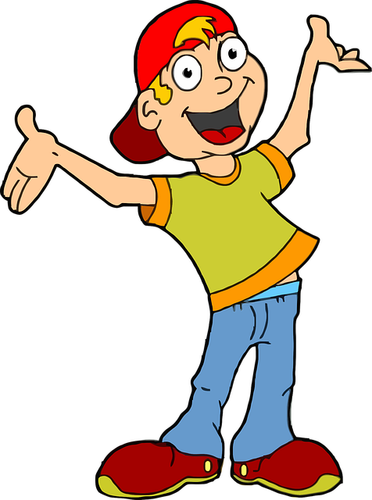
Introduction:
I AM A BOY, I AM 13 YEARS OLD

Slide 3

HOW I LOOK LIKE
I AM TALL
I AM HANDSOME
I HAVE BROWN EYES
I HAVE BROWN HAIR
Notes:
I AM TALL

Slide 4
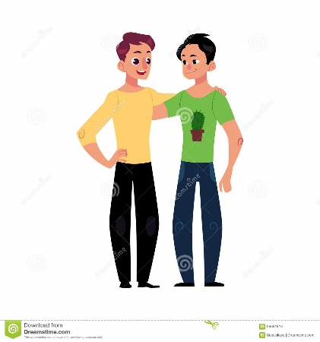
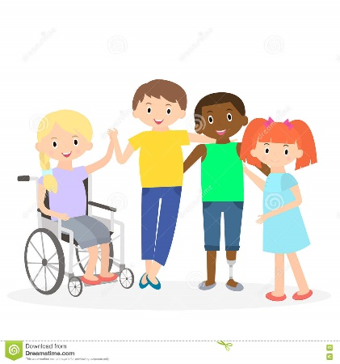
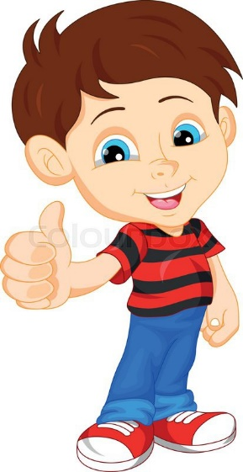
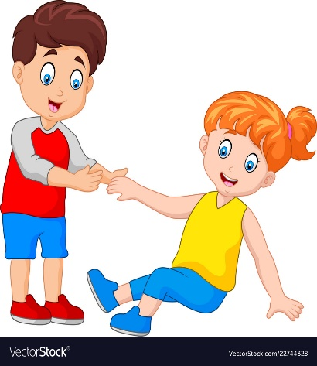
What is my character
I am friendly
I am sociable
I am nice
I am helpful

Slide 5
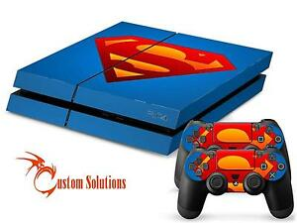
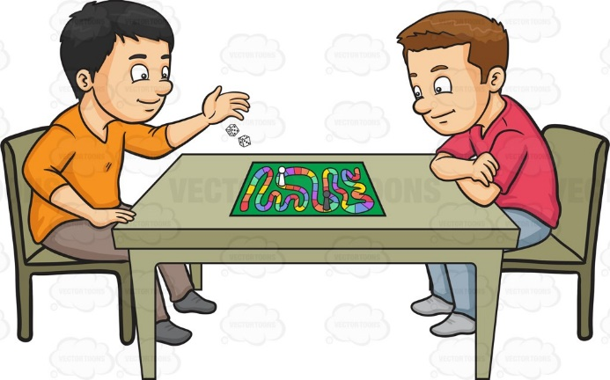
My favourite games
I like:
play station
table games with friends

Slide 6
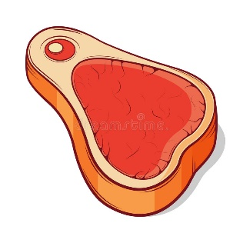
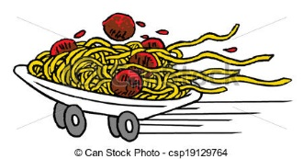
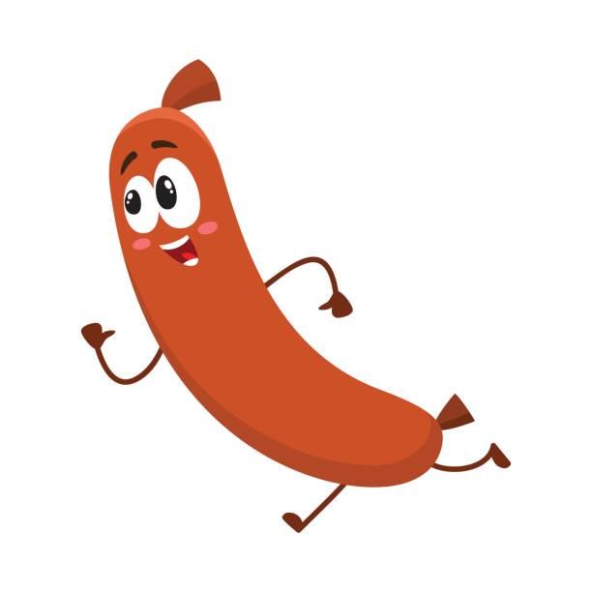

The food I like
I like
Pasta Meat
sausages
Fish
h
steak
Pasta carbonara
salmon
Notes:
sausage

Slide 7
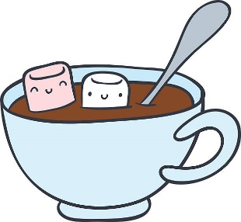


My Favourite sweet food is chocolate
Hot Chocolate
hot chocolate
with milk
Ice cream
chocolate and vanilla ice cream
Chocolate bar

Slide 8
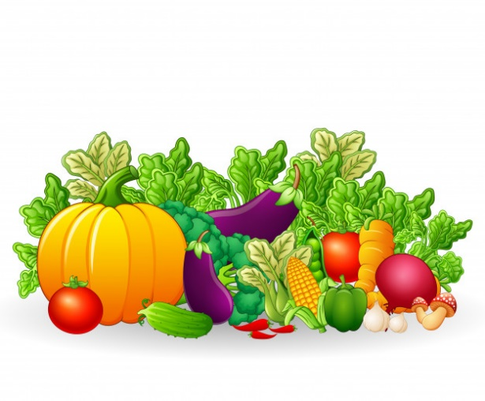
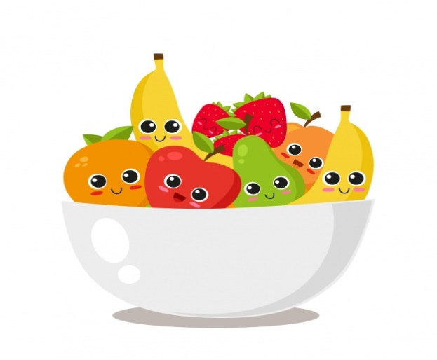
Everyday I eat lots of vegetables
Vegetables: Carots, Green beans, Asparagus, Spinach, Broccoli.
Fruit: Apples, Pears, Cherries, Peaches
Peppers, Onions

Slide 9
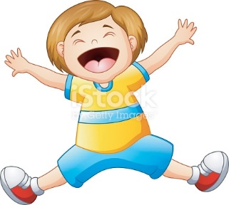
Conclusion
I am a very happy person.

